Slide 1


Console App
Bank Operations

Slide 2

CONTENT
01
Python and it’s Implementation
02
SCOPE OF PROJECT
03
Class Design 1
04
Class Design 2
05
Requirement Framing
06
Operating Environment
07
Summary of Application

Slide 3
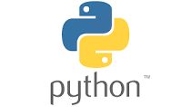

Python
Python and it’s Implementation
Python is implemented as an interpreted language, which means that the code is executed line by line by the Python interpreter. This makes Python very fast to develop with.
Python is a powerful and versatile programming language that is used for a variety of tasks. It is easy to learn and use, and it has a large number of libraries for common tasks i.e. Matplotlib, Pandas, Numpy.

Slide 4

SCOPE OF PROJECT
Banking operating system
Deposit Money
Withdraw Money
Fund Transfer
Balance Enquiry

Slide 5
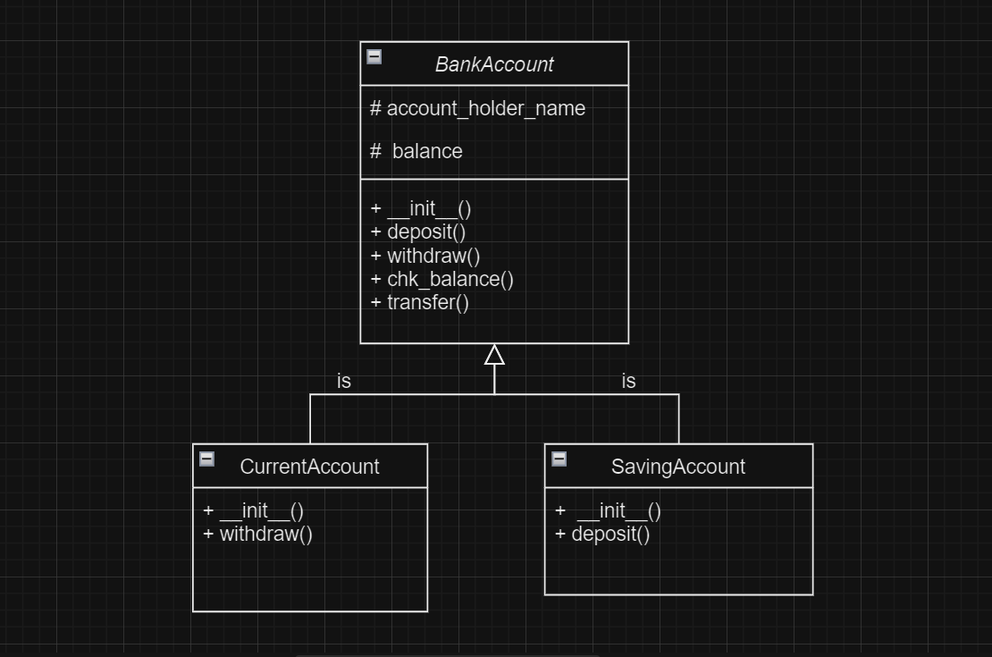
Class Design -Individual Classes

Slide 6
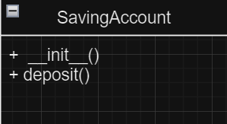
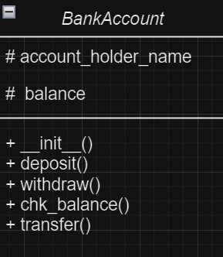
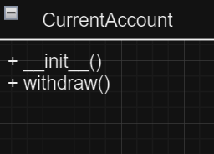

Class Design – On a Single Canvas

Slide 7
Functional Requirements of App

Slide 8
Requirement ID | Requirement CATEGORY | Requirement TYPE | PRIORITY | HIERARCHY | REF
R001 | FUNCTIONAL | STATED | HIGH
Requirement DESCRIPTION | Windows os , Pycharm
SCOPE | Showing Balance , Deposit money, Withdraw money, Getting Interest and Transfer money from one account to another account
METHODOLOGICAL DETAILS of Requirement | Create a Class named Bank_Account. Create methods in it like Deposit(),Withdrawal(),Show_Balance(), Transfer() The money should be consistent through out the process Deposited and withdrawal money should be reflected in the corresponding account In code, the methods should have Single Responsibility each The methods should be reused

Slide 9


OPERATING ENVIRONMENT
01
02
03
04
Windows
Mac
Linux
Docker

Slide 10
SUMMARY OF APPLICATION
The Python-based Banking Operation System is a console application designed to manage banking activities such as deposit, withdrawal, transfers, and balance inquiries. The project includes classes like BankAccount, SavingsAccount, and CurrentAccount, each with specific functionalities. The architecture follows a client-server model, featuring a text-based user interface for clients. Python serves as the core programming language. Testing encompasses scenarios like deposits, withdrawals, transfers, and error handling. The project aims to provide efficient and organized banking operations through a console interface.

Slide 11

THANK YOU
By :
Mehak Nautiyal

